Slide 1






PRN No. | Roll No. | Student Name
12220006 | 01 | Pratik Dhame
12220161 | 08 | Siddhesh Shinde
12220177 | 11 | Rishikesh Sanjekar
12220212 | 14 | Soham Dixit

Slide 2


Introduction
01
Aim & Objectives
02
Literature Review
03
Proposed System
05
Scope of Project
06
Feasibility of Project
07
Algorithms
08
Architecture
09
Conclusion
10
References
11

Slide 3


Plant diseases have a significant impact on crop yields and food security, and early detection and control are crucial for minimizing their impact.
Weather conditions play a major role in the development and spread of plant diseases.
Temperature, humidity, and humidity are just a few of the factors that can affect the susceptibility of plants to disease.
By using weather data to predict the onset and severity of plant diseases, farmers and agricultural managers can take proactive
measures to protect their crops.
01

Slide 4














Aiding farmers in the early detection of plant diseases
To control the spread of diseases in plants
To help farmers to know about potential disease through weather
02

Slide 5

Paper, Year & Publisher | Methodoloy | Data collection | Algorithm & Measurement Parameters
Predicting rice diseases across diverse agro-meteorological conditions using an artificial intelligence approach (2022) - PeerJ | Describes a study that aimed to develop a machine learning model to predict rice diseases across different agro-meteorological conditions. | Dataset was obtained by Visual Crossing Weather Platform and IMD. | ANN - Accuracy of 92.15%
Impact of temperature condition in crop disease analyzing using machine learning algorithm (2022) - ScienceDirect | Aims to investigate the impact of temperature on crop disease and develop a machine learning model to predict crop disease based on temperature data. | Dataset of 500 sample Images | KNN (81%) and Max Voting (91%)
Weather Based Prediction Of Early Blight Of Potato Caused By Alternaria Solani (2022) - Agricultural Mechanization in Asia | Aims to develop a weather-based prediction model for early blight of potato caused by the fungus Alternaria solani. | Weather data was collected from collected from Agro-Meteorological Section, of SKUAST-Jammu | Multiple linear regression. Mean Absolute Error of 0.1532 Root Mean Square Error of 2.932
Internet of Things (IoT) and Machine Learning Model of Plant Disease Prediction–Blister Blight for Tea Plant (2022) - IEEE Explore | Describes a system that uses machine learning and IoT to predict the occurrence of Blister Blight disease in tea plants by analyzing environmental data like rainfall, temperature, and humidity. | Data was collected using the IoT tools in the region of Hainan Island | Multiple Linear Regression with accuracy of 91%
03

Slide 6
Paper, Year & Publisher | Methodoloy | Data collection | Algorithm & Measurement Parameters
Rice-Fusion: A Multimodality Data Fusion Framework for Rice Disease Diagnosis (2022) - IEEE Explore | A multimodal data fusion framework was developed to improve the diagnosis of rice disease by combining data from IoT and images of diseased plants resulting in 95.31% accuracy. | The Dataset includes agrometeorological data collected using IoT and 3200 diseased plant images captured by a charged coupled device. | The Multimodal Rice-Fusion framework was built on top of CNN and MLP concatenation which resulted in 95.31% testing accuracy.
Impact of temperature condition in crop disease analyzing using machine learning algorithm (2022) - ScienceDirect | The Max Voting method was found to be more efficient and effective than the K-Nearest Neighbor (KNN) method in disease prediction, with 91% accuracy and 3.97 RMSE. | Kaggle dataset: Dataset of 500 sample Images is used for both Algorithms where 90% is used for training the model and 10% for testing | Max voting gives 91% Accuracy with 3.97 RMS error and KNN gives 88% accuracy with 4.34 RMS error
Rice Transformer: A Novel Integrated Management System for Controlling Rice Diseases (2022) - IEEE Explore | The authors propose a framework called "Rice- Fusion" that uses deep neural network as the main classifier and outperforms other state-of- the-art methods for rice disease diagnosis. | The dataset used consists of 4200 real time customized samples which again consists of 840 samples for each class | Model achieved accuracy of 97.38% which is trained from Dataset of 4200 images which includes visible. light images, thermal images, and near- infrared images
A Forecasting Technique for Powdery Mildew Disease Prediction in Tomato Plants (2021) - Springer | The study focuses specifically on powdery mildew disease, which is a significant disease affecting tomato plants. | Data was collected from sensors installed in farms. | K-Nearest Neighbor (KNN), Decision tree, Random forest. Highest accuracy: 93.24%
04

Slide 7
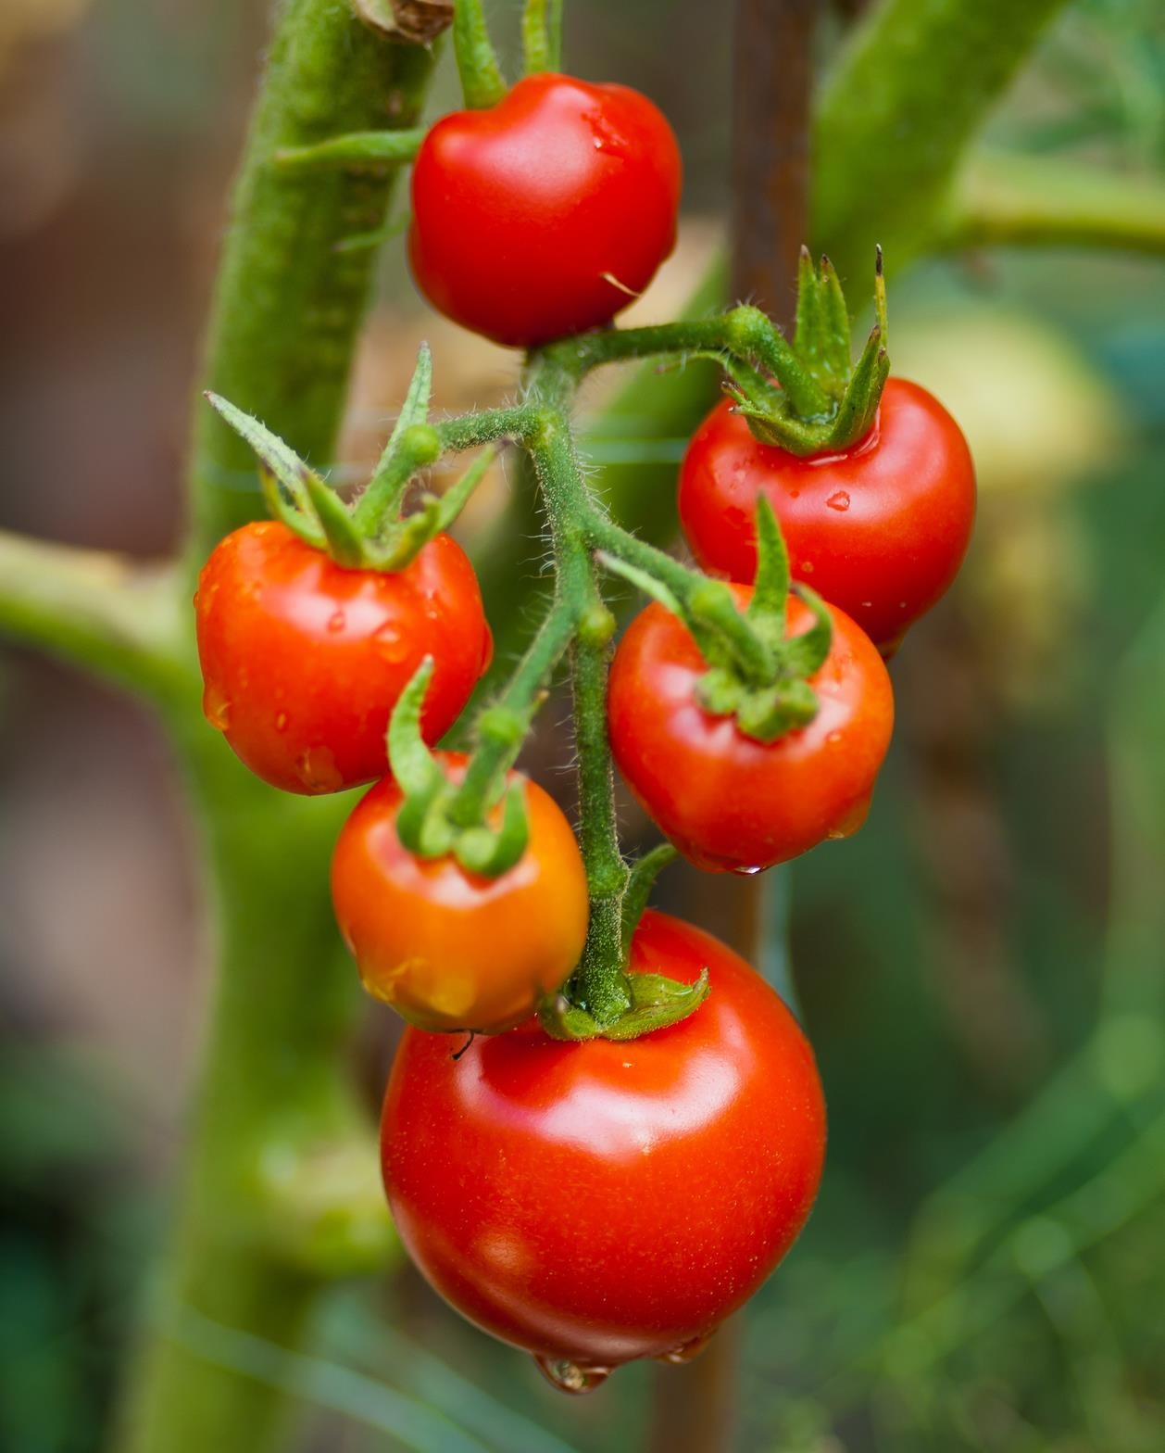


Predicting the plant disease based on the weather conditions
Includes parameters such as leaf wetness duration and global radiation.
As a result, it would be helpful for farmers to know beforehand about the
disease
05

Slide 8






Weather-based plant disease prediction involves using historical weather data and machine learning algorithms to predict the likelihood of a particular plant disease outbreak.
Collecting temperature,
and analyzing data on
and
precipitation, humidity,
other weather factors, as well as using machine learning algorithms to make predictions about disease occurrence
Evaluating the accuracy of the model using statistical methods and making any necessary adjustments.
06

Slide 9







Necessary resources such as computational power, data storage, and personnel with the necessary skills are available.
Data can be accessed from available sources such as weather stations, satellites etc.
Benefits such as preventing crop loss and increasing crop yields outweigh the costs incurred.
Machine learning techniques can effectively predict plant diseases based on weather data.
Project is relevant to current agricultural scenario and has positive impact on the industry.
07

Slide 10


















Used as base model in ensemble learning
Tabular data augmentation technique
Used as base model in ensemble learning
Used as base model in ensemble learning
Used as base model in ensemble learning
Used as meta model in ensemble learning
08

Slide 11

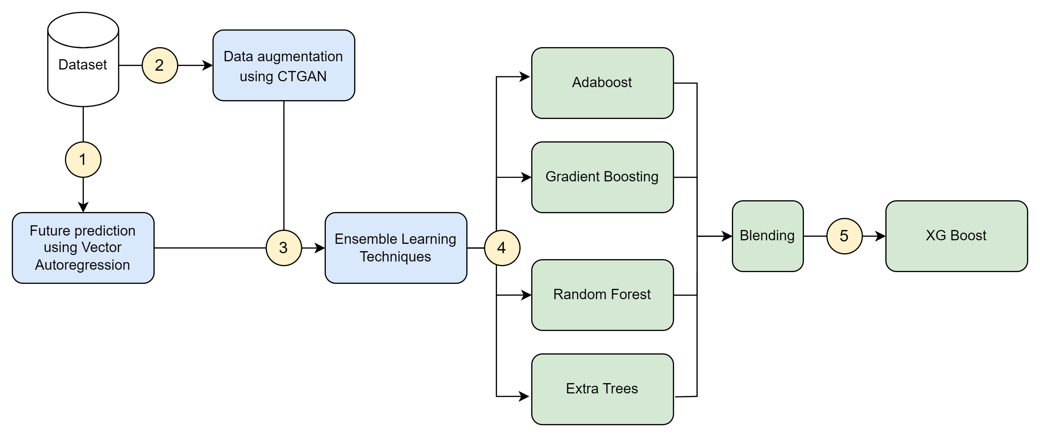
1
2
4
3
09

Slide 12




Helping farmers and agricultural organizations to prevent or mitigate the effects of plant diseases by providing early warning of disease outbreaks.
Significant economic benefits by reducing crop losses, increasing crop yields, and saving money on disease management.
With the increasing importance of predicting plant disease outbreaks due to changing weather patterns, this project could have a positive impact on the agricultural industry.

Slide 13

Hussain, Rafakat, et al. "Weather Based Prediction Of Early Blight Of Potato Caused By Alternaria Solani." Weather
53.02 (2022).
Patil RR, Kumar S. Predicting rice diseases across diverse agro-meteorological conditions using an artificial intelligence approach. PeerJ Comput Sci. 2021 Sep 3;7:e687. doi: 10.7717/peerj-cs.687. PMID: 34604518; PMCID: PMC8444092.
Z. Liu, R. N. Bashir, S. Iqbal, M. M. A. Shahid, M. Tausif and Q. Umer, "Internet of Things (IoT) and Machine Learning Model of Plant Disease Prediction–Blister Blight for Tea Plant," in IEEE Access, vol. 10, pp. 44934-44944, 2022, doi: 10.1109/ACCESS.2022.3169147.
R. R. Patil and S. Kumar, "Rice-Fusion: A Multimodality Data Fusion Framework for Rice Disease Diagnosis," in IEEE Access, vol. 10, pp. 5207-5222, 2022, doi: 10.1109/ACCESS.2022.3140815.
Lee KT, Han J, Kim KH. Optimizing Artificial Neural Network-Based Models to Predict Rice Blast Epidemics in Korea. Plant Pathol J. 2022 Aug;38(4):395-402. doi: 10.5423/PPJ.NT.04.2022.0062. Epub 2022 Aug 1. PMID: 35953059; PMCID: PMC9372109.
S. Sannakki, V. S. Rajpurohit, F. Sumira and H. Venkatesh, "A neural network approach for disease forecasting in grapes using weather parameters," 2013 Fourth International Conference on Computing, Communications and Networking Technologies (ICCCNT), 2013, pp. 1-5, doi: 10.1109/ICCCNT.2013.6726613.

Slide 14
V. Tilva, J. Patel and C. Bhatt, "Weather based plant diseases forecasting using fuzzy logic," 2013 Nirma University International Conference on Engineering (NUiCONE), 2013, pp. 1-5, doi: 10.1109/NUiCONE.2013.6780173.
Bhatia, A., Chug, A., Singh, A.P., Singh, R.P., Singh, D. (2022). A Forecasting Technique for Powdery Mildew Disease Prediction in Tomato Plants. In: Gupta, D., Khanna, A., Kansal, V., Fortino, G., Hassanien, A.E. (eds) Proceedings of Second Doctoral Symposium on Computational Intelligence . Advances in Intelligent Systems and Computing, vol 1374. Springer,
Singapore. https://doi.org/10.1007/978-981-16-3346-1_41
T. Nalini, A. Rama, Impact of temperature condition in crop disease analyzing using machine learning algorithm, Measurement: Sensors, Volume 24, 2022, 100408, ISSN 2665-9174, https://doi.org/10.1016/j.measen.2022.100408.
R. R. Patil and S. Kumar, "Rice Transformer: A Novel Integrated Management System for Controlling Rice Diseases," in IEEE Access, vol. 10, pp. 87698-87714, 2022, doi: 10.1109/ACCESS.2022.3200688.
BAKEER A.R.T., et al "VALIDATION OF TOMATO POWDERY MILDEW FORECASTING MODEL USING METEOROLOGICAL DATA IN EGYPT." International Journal of Agriculture Sciences 5.2 (2013):372-378. http://dx.doi.org/10.9735/0975-3710.5.2.372- 378

Slide 15





